Slide 1
SAGE Lecture Spark
[February 22, 2021]
Notes:
The Publisher of the Social Sciences

Slide 2
Key Concepts
KC1: Compare and contrast the Myanmar Protest and government response with the Summer 2020 protests in the United States.
KC2: Discuss how the military industrial complex – interconnection among business, military, and government – drive the normalization of lethal responses to public protest.
KC3: Explain the role of media (specifically social media) in contributing to the narrative that emerges related to acts of civil disobedience.
Notes:
AUDIO/TEXT: https://www.npr.org/2021/02/18/968921933/request-for-myanmars-military-to-relinquish-control-goes-unheeded
TEXT: https://www.bbc.com/news/world-asia-56074429
TEXT: https://www.reuters.com/article/myanmar-politics-facebook/facebook-takes-down-main-page-of-myanmar-military-idUSL1N2KR00Z
TEXT/VIDEO: https://www.cnn.com/2021/02/20/asia/myanmar-police-protestors-reports-shooting-intl/index.html
TEXT: https://www.voanews.com/east-asia-pacific/thousands-protest-myanmar-after-2-demonstrators-killed
TEXT: https://www.vox.com/2021/2/14/22282818/myanmar-protests-military-coup-arrest-suu-kyi
TEXT/VIDEO: https://www.theguardian.com/world/2021/feb/14/tanks-on-streets-of-myanmar-city-prompt-us-embassy-warning
TEXT/VIDEO: https://www.cnn.com/2021/02/08/asia/myanmar-coup-protests-democracy-intl-hnk/index.html

Slide 3
Myanmar Protests
On February 1, 2021 members of the Myanmar military, led by Min Aung Hlaing (the Commander-in-Chief of the Tatmadaw, overthrew the recently installed administration of the pro-democracy National League for Democracy (NLD) party. As of this past week, over 450 members of the part are being detained, most without any formal charges or evidence, by military forces. Public protests have erupted in the country ever since, with members wearing red (the color most commonly associated with the NLD), engaging in acts of civil disobedience including labor walkouts, boycotting companies associated with funding and supporting the military, and formally recognizing the results of their democratic election as the true definition of who should be leading their country. In response, the military forces have used internet blackouts and criminal sentences against protestors. Saturday, the military showed the lengths they were willing to go to protect their position. Opening fire on civilian protestors, 40 were wounded and 2 were killed in the bloodiest day in the peaceful resistance to authoritarian rule in a country that is no stranger to military rule, having battled it since the last military coup on March 2, 1962. In this week’s Lecture Spark, we explore the most recent forced removal of the first non-military pro-democratic administration through the lens of sociology. Specifically, we use the concepts of authoritarianism, social control, ethnocentrism, the military-industrial complex, and media as an instrument of social change.

Slide 4
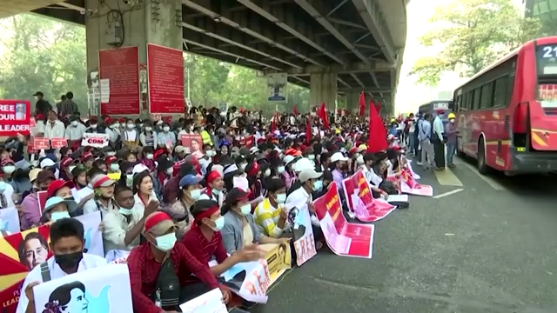
Myanmar Protests
Myanmar protesters undeterred by worst day of violence
https://youtu.be/LIswOOUyPoc
Tens of thousands of opponents of Myanmar military coup gathered again on Sunday across the country, undeterred by the bloodiest episode of their campaign the previous day when security forces killed two protesters

Slide 5
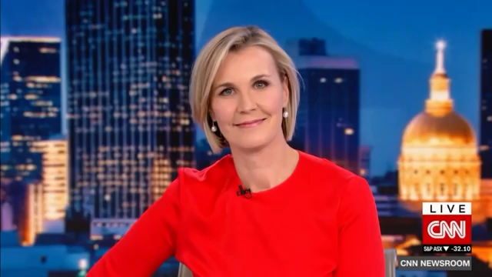
Myanmar Protests
Risk of violence grows in Myanmar as protesters remain defiant
https://youtu.be/gz8jCYuIPLQ
Anti-coup protests grow bigger and more committed in Myanmar despite gunfire and military tanks on the streets. But as tensions rise between the two sides, United Nations official warns of the possibility of a bloodbath.

Slide 6
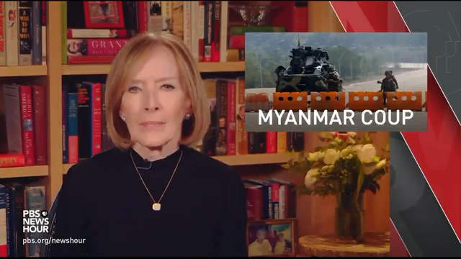
Myanmar Protests
Why Myanmar's military overthrew the nation’s democratically elected government
https://www.youtube.com/watch?v=qekJvP_eUPA
The Biden administration has threatened to reimpose sanctions on Myanmar after the military there staged a coup over the weekend.

Slide 7
Discussion Questions
At what point is it acceptable for military forces to use lethal force against civilian populations of their own country? What circumstances must be present for this type of retaliation to be justified? Why is it necessary for authoritarian leaders to use force and fear to control their citizens? What does that say about this form of government?
What conditions are necessary for this type of occurrence – the coup and retaliation to the protestors – to occur in the United States? What is the relationship between government, business, and military that drives the normalization of strong responses intended to suppress opposition from civilians to government policies and actions?
What are the limits of social control that you are willing to have imposed upon your attitudes and behaviors by the government? What freedoms are most important to you that, if forcibly removed from you, would spark a motivation to stand up against the government? Why might others refrain from protesting? What is there to gain from protesting, and what is there to lose?
In what ways do you think protests from a recent as the summer of 2020 compare to the current protests in Myanmar in terms of size, composition, strategy, and intensity? How might someone argue that the protests in the United States last year and the response from law enforcement were more civilized than what is happening in Myanmar right now? How do you think they compare?
Why might the military decide to cut the internet? What is the role of media, specifically social media, in resistance to authoritarian rule? What does the military have to gain from cutting the internet and what do the protestors have to lose in the absence of internet access? How might the group that controls the narrative surrounding events related to the protest control the response?

Slide 8
Current Events Quiz
An individual using a(n) _______ perspective might compare the protests in Myanmar to protests in the United States in a way that judges those in the United States more favorably than those in Myanmar because of a sense of cultural superiority belonging to the Untied States.
Dominant
Critical
Culturally Relative
Ethnocentric

Slide 9
Current Events Quiz
The military-industrial complex is a term used to describe the interconnection of _______, _______, and _______ that illustrate how capitalism drives decision making for all three.
military, social class, and gender
military, economy, and government
military, banks, and corporations
military, factories, construction

Slide 10
Current Events Quiz
A sociologist using the _______ perspective would likely be interested in researching how individuals define the images they see in social media about the protests differently from those in the dominant media and how that influences their interpretation and response to the events.
Functionalist
Symbolic-Interactionist
Conflict
Rational Choice

