Slide 1
SAGE Lecture Spark
11/12/2019
Notes:
The Publisher of the Social Sciences

Slide 2
China Rolls Out World’s Largest 5G Mobile Phone Network
In late October, “China’s three state-owned wireless carriers debuted 5G mobile phone services.”
“The largest cities including Beijing, Shanghai and Shenzhen will get full coverage first. The three operators have projected a combined capital spending of 302 billion yuan this year.”
More than 10 million Chinese customers have already pre-registered for 5G. They “will have access to faster videos and games, more virtual reality applications and improved performance for mobile videoconferencing.”
Notes:
https://www.bloomberg.com/news/articles/2019-10-30/china-to-roll-out-world-s-largest-5g-mobile-phone-network

Slide 3
Smart Home Neighborhoods
Smart home neighborhoods are emerging across America. “There are smart home developments in suburbs outside of cities such as Miami and San Francisco [and Seattle].”
Lennar Homes, a home builder, is “making Amazon tech standard on each of the 45,000 homes it builds this year.”
According to a representative from Second Century Ventures, an investment arm of the National Association of Realtors, “There's a new narrative when it comes to what 'home' means. It means a personalized environment where technology responds to your every need.”
Notes:
https://www.npr.org/2019/11/09/777747209/a-smart-home-neighborhood-residents-find-it-enjoyably-convenient-or-a-bit-creepy

Slide 4
5G Increasingly Available in U.S.
“Verizon's mobile 5G network is expected to expand to over 30 cities by the end of the year [2019].”
AT&T launched its 5G network in several cities in late 2018 and is now available in at least 21 cities.
Under the terms of the T-Mobile and Sprint merger, the companies “will have six years from the close to complete its 5G build-out requirements.”
“T-Mobile currently offers access to its 5G network to Samsung Galaxy S10 5G users in select areas of Atlanta, Cleveland, Dallas, Las Vegas, Los Angeles and New York.”
Notes:
https://www.cnn.com/2019/04/09/tech/5g-network-us-cities/index.html

Slide 5
Battle Around Antennas for 5G Wireless in Maryland
In anticipation of offering 5G service, “Baltimore’s streets are dotted with more than 600 ‘small cell wireless facilities’ on streetlights and utility poles, making the city one of the first areas in Maryland to welcome the new technology.”
The wireless industry and local governments are wrestling to figure out how to deploy this technology. “The industry wants a clear path to install the equipment and would like to see statewide legislation, while local governments want to control where the facilities go and what they look like.”
Notes:
https://www.baltimoresun.com/politics/bs-md-pol-small-cell-towers-20191107-kpzpdakqfzatbneutzcv2rlguq-story.html

Slide 6
Key Concepts
From “5G & the Future of Connectivity”
5G technology is increasingly available in many U.S. cities. The recent announcement of 5G services being available in China will likely spur more aggressive competition among firms all over the world to rollout 5G.
Increased connectivity—in terms of both speed and capability—is changing our lives and culture, including the proliferation of mobile devices and smart devices in homes, cars and accessories as part of our day-to-day experience.
Meanwhile, governments are catching up on how to regulate and accommodate this technology.

Slide 7
Assessment
Writing: What precautions should we take as a nation and as individuals to make sure that the capability for 5G is used to improve people’s lives? Do you anticipate that any problems or conflicts could be worsened with the onset of more advanced connected networks?
Debate: 5G may facilitate the expansion of the ecosystem of connected devices (Internet of Things). Is there greater risk or reward with a more advanced Internet of Things?
Notes:
1. Lennar Homes was featured in the NPR article, “A Smart Home Neighborhood: Residents Find It Enjoyably Convenient Or A Bit Creepy.” What does the company specialize in?
a. Building luxury apartment buildings that have top-notch security features, including video surveillance
b. Retrofitting old homes with fiber and voice recognition technology
c. Building homes that have Amazon smart home technology as a standard
d. Building homes that are “off-the-grid,” meaning it can generate its own power
2. Baltimore already has more than 600 small cell wireless facilities. Where are these facilities located?
a. On streetlights and utility poles
b. At the top of buildings that are at least three stories tall
c. Throughout parks and government buildings
d. On parking meters
3. Which statement is true about the state of 5G in America?
a. 5G is primarily available in only certain cities, and carriers have ambitious plans to continue expanding the capability.
b. 5G is not yet available anywhere in the U.S.
c. 5G was piloted in rural areas of the U.S. and the results of the pilot program indicate that there is little demand for 5G in the U.S.
d. 5G was piloted only in the Midwest and carriers are ambitiously trying to expand it to other regions.
4. In the IEEE Spectrum video, “Everything You Need to Know About 5G,” Massive MIMO is described as a technology that allows base stations to have up to 100 ports to increase their capacity by 22 or more (compared to 4G base stations). What does MIMO stand for?
a. More Internet Maximum Overlay
b. Multiple Internet Modem Outputs
c. Multiple Input Multiple Output
d. Maximum Interface Modulation Overpass
5. In the BBC Click video, Vint Cerf, co-founder of the Internet, emphasizes that the future of the Internet will be:
a. Driven by Gen Z
b. Used to explore the core of the Earth
c. Interplanetary
d. Embedded into human bodies

Slide 8
Assessment
Poll: Do you agree or disagree with this statement: 5G will revolutionize my life for the better!
Agree: 5G will improve my life.
Disagree: 5G will be inconvenient or disruptive to my life.
Neither: 5G will not contribute any change to my life.
Short Answer: What capabilities would you want the future of the Internet and connected networks to provide to you?
Notes:
1. Lennar Homes was featured in the NPR article, “A Smart Home Neighborhood: Residents Find It Enjoyably Convenient Or A Bit Creepy.” What does the company specialize in?
a. Building luxury apartment buildings that have top-notch security features, including video surveillance
b. Retrofitting old homes with fiber and voice recognition technology
c. Building homes that have Amazon smart home technology as a standard
d. Building homes that are “off-the-grid,” meaning it can generate its own power
2. Baltimore already has more than 600 small cell wireless facilities. Where are these facilities located?
a. On streetlights and utility poles
b. At the top of buildings that are at least three stories tall
c. Throughout parks and government buildings
d. On parking meters
3. Which statement is true about the state of 5G in America?
a. 5G is primarily available in only certain cities, and carriers have ambitious plans to continue expanding the capability.
b. 5G is not yet available anywhere in the U.S.
c. 5G was piloted in rural areas of the U.S. and the results of the pilot program indicate that there is little demand for 5G in the U.S.
d. 5G was piloted only in the Midwest and carriers are ambitiously trying to expand it to other regions.
4. In the IEEE Spectrum video, “Everything You Need to Know About 5G,” Massive MIMO is described as a technology that allows base stations to have up to 100 ports to increase their capacity by 22 or more (compared to 4G base stations). What does MIMO stand for?
a. More Internet Maximum Overlay
b. Multiple Internet Modem Outputs
c. Multiple Input Multiple Output
d. Maximum Interface Modulation Overpass
5. In the BBC Click video, Vint Cerf, co-founder of the Internet, emphasizes that the future of the Internet will be:
a. Driven by Gen Z
b. Used to explore the core of the Earth
c. Interplanetary
d. Embedded into human bodies

Slide 9
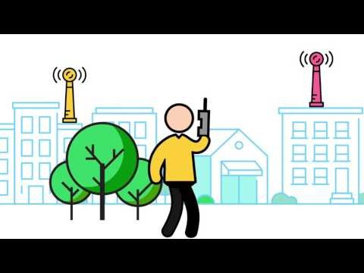
Notes:
IEEE Spectrum: Everything You Need to Know About 5G https://www.youtube.com/watch?v=GEx_d0SjvS0

Slide 10
Notes:
BBC Click: Vint Cerf Talks The Future Of The Internet https://www.youtube.com/watch?v=U2AmxZ3V26s

Slide 11
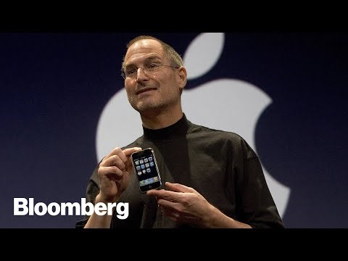
Notes:
Bloomberg: Why Smartphones Stopped Being Cool https://www.youtube.com/watch?v=RxHZTNquCL8

