Slide 1
SAGE Lecture Spark
[October 21, 2019]
Notes:
The Publisher of the Social Sciences

Slide 2
Key Concepts
KC1: Understand and explain the issues of sex trafficking and mass incarceration through the functionalist and conflict perspective.
KC2: Explain the role of hegemonic masculinity in the context of sex trafficking.
KC3: Discuss how the media contributes to the social construction of sex trafficking victims.
Notes:
TEXT/VIDEO: https://www.democracynow.org/2019/10/18/cyntoia_brown_long_sex_trafficking_survivor
TEXT: https://www.bbc.com/news/newsbeat-50082326
TEXT: https://www.bet.com/news/national/2019/10/16/cyntoia-brown-long-on-getting-married-while-incarcerated--being-.html
TEXT: https://www.npr.org/2019/08/07/749025458/cyntoia-brown-released-after-15-years-in-prison-for-murder
TEXT: https://www.vox.com/the-highlight/2019/8/23/20828367/cyntoia-brown-sexual-domestic-abuse-prison-pipeline
TEXT: https://www.motherjones.com/crime-justice/2019/01/cyntoia-brown-clemency-bill-haslam-tennessee/
TEXT: https://www.nbcnews.com/news/us-news/who-cyntoia-brown-celebrities-rally-behind-teen-sentenced-life-prison-n823786
TEXT: https://www.npr.org/2017/12/01/567789605/cyntoia-brown-case-highlights-how-child-sex-trafficking-victims-are-prosecuted
TEXT: https://www.nationalreview.com/2019/08/cyntoia-brown-freed-time-for-systemic-change-way-we-view-criminal-offenses/

Slide 3
Cyntoia Brown-Long Released
Cyntoia Brown-Long was released from prison in August 2019 after serving 15 years of a 51-year sentence for killing a man in self-defense who solicited her for sex. At the time, 2004, Brown was being involuntarily prostituted, raped, and abused by a man who organized the transaction. Although on Parole, Brown is making the most of her second chance at life by capitalizing on her educational accomplishments while incarcerated – she earned her GED, AA, and eventually BA from Lipscomb University – and turning her test into a testimonial she can share with the world in an effort to raise awareness and support for individuals experiencing similar situations. She also released a book this last week detailing her story and road to redemption. This week we explore the release of Cyntoia Brown-Long with specific emphasis on the contributions of celebrities in her release, social construction of Brown-Long through the media, and hegemonic masculinity.

Slide 4
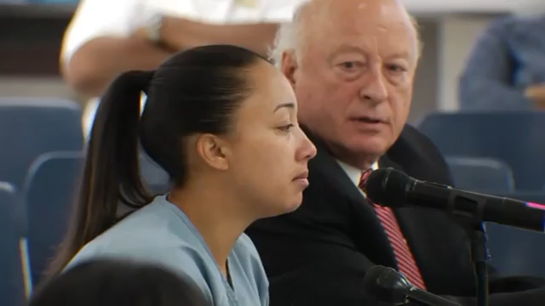
Cyntoia Brown-Long Released
Notes:
Cyntoia Brown: From convicted murderer to victims' advocate
Filmmaker Daniel Birman has been documenting Brown's journey from when she was first arrested at 16 for murdering a real estate agent she claimed solicited her for sex.
https://www.youtube.com/watch?v=hc2ggQ7sc3o

Slide 5
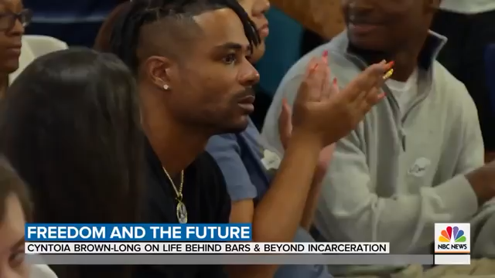
Cyntoia Brown-Long Released
Notes:
Cyntoia Brown-Long Opens Up About Her Fight for Freedom | TODAY
Cyntoia Brown-Long was 16 when she was sentenced to life in prison for killing a man who solicited her for sex. After 15 years behind bars and a celebrity-backed campaign to reconsider her sentence, she's free. Brown-Long, who shares her story in a new book, "Free Cyntoia," joins TODAY to open up about her future. "I'm here by the grace of God," she tells Craig Melvin.
https://www.youtube.com/watch?v=LcNqhZU9lRA

Slide 6
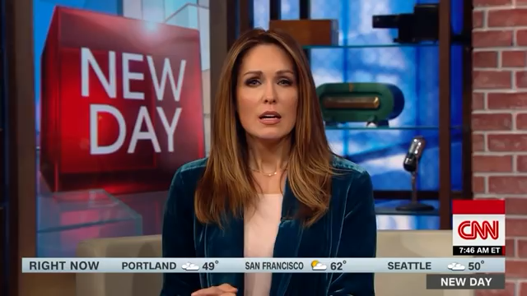
Cyntoia Brown-Long Released
Notes:
Social media reignites Cyntoia Brown murder case
Cyntoia Brown is serving a life sentence for the murder of a Nashville man in 2004. According to Brown, after a childhood marked by abuse and drugs, she was raped and forced into prostitution by a pimp, and ended up killing one of her clients out of self-defense when she was 16 years old.
https://www.youtube.com/watch?v=QqXdDXuKfS0

Slide 7
Discussion Questions
Why did celebrities get involved with Cyntoia’s case? How did their attention bring awareness, and ultimately freedom, for Cyntoia? How would her situation have been different without this exposure? Are more celebrities involved with justice issues to raise their own profile than those truly for the cause? Explain.
From a functionalist standpoint, what role do religion and family play in the life of inmates? How do these two social institutions converge to provide inmates with support during their incarceration and adjudication? Why are they necessary for one to survive incarceration and successfully transitioning back into civilian life?
From a conflict perspective, why do most inmates languish in prisons across America due to similar miscarriages of justice? Why is there such a high price on freedom in America? How does this largely unattainable price create opportunities for competition and exploitation in America?
How does coverage of Cyntoia by media outlets lead to the social construction, and ultimately cultural perception, of her and her story? What is the role of media in prison reform? Why might the success of any reform measures be contingent on public will and sentiment about prisoners, their life, their family, and more?
What is the role of hegemonic masculinity in Cyntoia’s story? In other words, how do the popularized notions of what it means to be a “man” in America contribute to the experiences leading up to the killing that led to Cyntoia’s incarceration and subsequent exoneration? What notions are most powerful?

Slide 8
Current Events Quiz
A conflict theorist would likely argue that…
…women who are exploited deserve what they get for staying in their abusive relationships.
…most victims of sexual assault are found to be lying to get attention from the media.
…victims of sex trafficking are often unfairly sentenced because of their diminished status due to race, gender, age, sexuality, social class, etc.
…blaming the victim culture influences how people interact with victims of sexual abuse.

Slide 9
Current Events Quiz
Which of the following aspects of Cyntoia’s story is of most interest to sociologists interested in investigating the role of hegemonic masculinity in American culture?
Her recent book tour that involves a number of interviews with men.
How she was able to be manipulated by an older man at the age of 16.
The fact that her victim, a 43-year old man, felt entitled to the body of a 16-year old black girl.
Her husband’s involvement in her release.

Slide 10
Current Events Quiz
From a functionalist perspective, a sociologist would likely argue that sex trafficking persists because it provides a necessary function for society. Which of the following is an example of one of these functions?
Social construction of deviance
Employment for police officers
Fodder for campaign speeches
Material used in television and films
All of the above…and more.

