Slide 1
SAGE Lecture Spark
[10/23/18]
Notes:
The Publisher of the Social Sciences

Slide 2
First Transgender Woman to Win Track World Title
“Rachel McKinnon has entered the history books as the first transgender woman to win a cycling world title.”
“Dr. Rachel McKinnon was born a biological male but [now] identifies as a trans woman and is a campaigner for trans rights.”
Notes:
https://www.cyclingweekly.com/news/latest-news/rachel-mckinnon-becomes-first-transgender-woman-win-track-world-title-397473

Slide 3
Cycling Bronze Medalist Cries Foul after Transgender Woman Wins Gold
“First transgender woman world champion...ever," Rachel McKinnon, an assistant professor of philosophy at the College of Charleston in South Carolina, bragged Sunday in a tweet that set off a massive debate.”
“It’s definitely NOT fair,” Jennifer Wagner, the third-place finisher from Houston, said in response to a tweet from British conservative Katie Hopkins.
Notes:
https://www.foxnews.com/sports/not-fair-world-cycling-bronze-medalist-cries-foul-after-transgender-woman-wins-gold

Slide 4
Commentary: The Complicated Case of Dr. Rachel McKinnon
“Some athletes are simply stronger or bigger than their competitors — no matter whether they are cisgender or transgender.”
“Rules can approximately create a fair competition by forbidding outright cheating, but no athlete expects to compete against others who are identically matched in size, strength, ability, or intelligence.”
Notes:
https://www.velonews.com/2018/10/news/commentary-the-complicated-case-of-transgender-cyclist-dr-rachel-mckinnon_480285

Slide 5
Transgender Canadian Woman Sets Off Debate after Winning Cycling World Championship
“McKinnon's achievement was lauded by some on social media as even more spectacular because she is forced to suppress her testosterone levels to what she deems "unhealthily low" levels as a pre-requisite for competing.”
McKinnon said, "We shouldn't be worried about trans people taking over the Olympics. We should be worried about their fairness and human rights instead."
Notes:
https://www.cbc.ca/sports/transgender-woman-track-cycling-1.4863381

Slide 6
Key Concepts
(Trans)Gender and Mass Communication:
Issues of sex and gender in mass media address what many scholars consider social constructions—our collective assumptions creating a shared reality.
When we discuss whether transgender people should compete, or how, we subscribe to the binary of male/female—that there can only be two genders/sexes.
It is interesting to examine how mass media can either propagate these norms, or challenge us to think in new ways.

Slide 7
Assessment
Writing: Explain how the inclusion of transgender athletes in sports challenge our understanding of sex and gender as binary, using theories such as social constructionism.
Debate: Would you consider transgender inclusion in sports a human rights issue, as Dr. McKinnon does? Why or why not?
Poll: Do you believe sex is fixed (unchangeable) or flexible (changeable)?
Short Answer: What does it mean to be transgender? Please give an example.
Notes:
Current Events Quiz
What is the name of the first transgender woman to win a world cycling title?
Rachel McKinnon had her status as winner challenged by Jennifer Wagner, the___.
No athlete can expect to compete against___.
Dr. McKinnon is more concerned with ___ than trans people taking over sports.
To compete, McKinnon’s ___ is suppressed
Answers
Rachel McKinnon
Bronze medalist
one who is identically matched in all capabilities
4. fairness and human rights
5. testosterone level

Slide 8
Notes:
https://www.youtube.com/watch?v=fWDhU-tgxxU
A commentary from Dr. Rachel McKinnon. “I offer some thoughts on how to think about whether including trans women in competitive sport is 'fair.' The IOC Principles of Olympism establish participation in sport as a human right; they also prohibit discrimination in various forms. I suggest that excluding trans women constitutes prima facie discrimination and does NOT meet the standard required to justify such discrimination. I also suggest some ways to think about 'fairness' in sport, and that including trans women in sport is consistent with fair competition.”

Slide 9
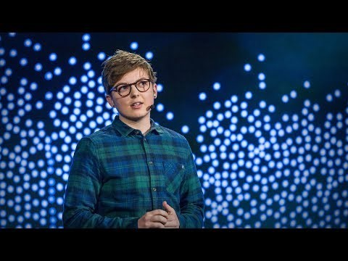
Notes:
https://www.ted.com/talks/jackson_bird_how_to_talk_and_listen_to_transgender_people?language=en
“Gender should be the least remarkable thing about someone, but transgender people are still too often misunderstood. To help those who are scared to ask questions or nervous about saying the wrong thing, Jackson Bird shares a few ways to think about trans issues. And in this funny, frank talk, he clears up a few misconceptions about pronouns, transitioning, bathrooms and more.”

